Slide 1
Course Name: Database Systems Course Code: CS52 Credits: 3:1:0 UNIT 4 Term: Oct 2021– Feb 2022
M.S. Ramaiah Institute of Technology
(Autonomous Institute, Affiliated to VTU)
Department of Computer Science and Engineering
Faculty:
Dr. Sini Anna Alex

Slide 2
Relational Database Design Algorithms and Further Dependencies
The two desirable properties of decompositions, namely,
the dependency preservation property and the lossless (or nonadditive) join property, which are both used by the design algorithms to achieve desirable decompositions.
Fourth normal form (4NF) and fifth normal form (5NF)

Slide 3
DESIGNING A SET OF RELATIONS
The Approach of Relational Synthesis (Bottom-up Design):
Assumes that all possible functional dependencies are known.
First constructs a minimal set of FDs
Then applies algorithms that construct a target set of 3NF or BCNF relations.
Additional criteria may be needed to ensure the the set of relations in a relational database are satisfactory

Slide 4
Properties of Relational Decompositions
Relation Decomposition and Insufficiency of Normal Forms:
Universal Relation Schema:
A relation schema R = {A1, A2, …, An} that includes all the attributes of the database.
Universal relation assumption:
Every attribute name is unique.

Slide 5
Properties of Relational Decompositions
Relation Decomposition and Insufficiency of Normal Forms (cont.):
Decomposition:
The process of decomposing the universal relation schema R into a set of relation schemas D = {R1,R2, …, Rm} that will become the relational database schema by using the functional dependencies.
Attribute preservation condition:
Each attribute in R will appear in at least one relation schema Ri in the decomposition so that no attributes are “lost”.

Slide 6
Properties of Relational Decompositions
Another goal of decomposition is to have each individual relation Ri in the decomposition D be in BCNF or 3NF.
Additional properties of decomposition are needed to prevent from generating spurious tuples.

Slide 7
Properties of Relational Decompositions
Dependency Preservation Property of a Decomposition:
Definition: Given a set of dependencies F on R, the projection of F on R_{i}, denoted by p_{Ri}(F) where R_{i} is a subset of R, is the set of dependencies X → Y in F⁺ such that the attributes in X υ Y are all contained in R_{i}.
Hence, the projection of F on each relation schema R_{i} in the decomposition D is the set of functional dependencies in F⁺, the closure of F, such that all their left- and right-hand-side attributes are in R_{i}.

Slide 8
Properties of Relational Decompositions
Dependency Preservation Property of a Decomposition (cont.):
Dependency Preservation Property:
A decomposition D = {R1, R2, ..., Rm} of R is dependency-preserving with respect to F if the union of the projections of F on each Ri in D is equivalent to F; that is ((π_{R1}(F)) υ . . . υ (π_{Rm}(F)))⁺ = F⁺
Claim 1:
It is always possible to find a dependency-preserving decomposition D with respect to F such that each relation Ri in D is in 3NF.

Slide 9
Properties of Relational Decompositions
Lossless (Non-additive) Join Property of a Decomposition:
Definition: Lossless join property: a decomposition D = {R1, R2, ..., Rm} of R has the lossless (nonadditive) join property with respect to the set of dependencies F on R if, for every relation state r of R that satisfies F, the following holds, where * is the natural join of all the relations in D:
* (π _{R1}(r), ..., π_{Rm}(r)) = r
Note: The word loss in lossless refers to loss of information, not to loss of tuples. In fact, for “loss of information” a better term is “addition of spurious information”

Slide 10
Properties of Relational Decompositions
Lossless (Non-additive) Join Property of a Decomposition (cont.):
Algorithm 11.1: Testing for Lossless Join Property
Input: A universal relation R, a decomposition D = {R1, R2, ..., Rm} of R, and a set F of functional dependencies.
1. Create an initial matrix S with one row i for each relation Ri in D, and one column j for each attribute Aj in R.
2. Set S(i,j):=bij for all matrix entries. (* each bij is a distinct symbol associated with indices (i,j) *).
3. For each row i representing relation schema Ri
{for each column j representing attribute Aj
{if (relation Ri includes attribute Aj) then set S(i,j):= aj;};};
(* each aj is a distinct symbol associated with index (j) *)
CONTINUED on NEXT SLIDE

Slide 11
Properties of Relational Decompositions
4. Repeat the following loop until a complete loop execution results in no changes to S
{for each functional dependency X →Y in F
{for all rows in S which have the same symbols in the columns corresponding to attributes in X
{make the symbols in each column that correspond to an attribute in Y be the same in all these rows as follows:
If any of the rows has an “a” symbol for the column, set the other rows to that same “a” symbol in the column.
If no “a” symbol exists for the attribute in any of the rows, choose one of the “b” symbols that appear in one of the rows for the attribute and set the other rows to that same “b” symbol in the column ;
}; }; };
5. If a row is made up entirely of “a” symbols, then the decomposition has the lossless join property; otherwise it does not.

Slide 12
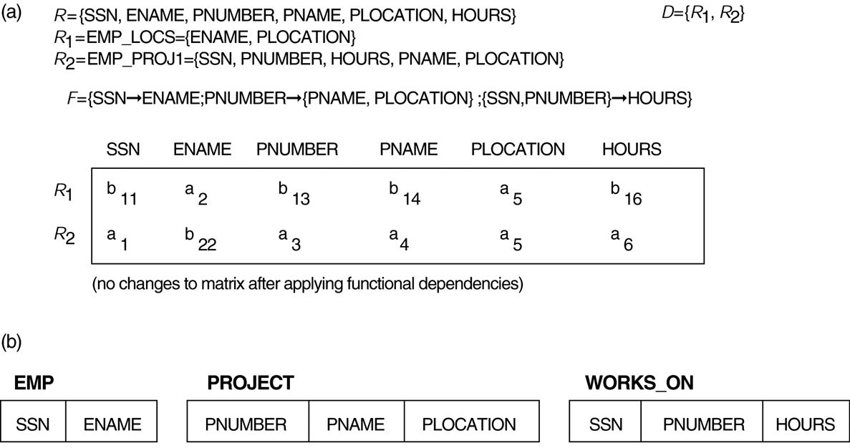
Properties of Relational Decompositions
Lossless (nonadditive) join test for n-ary decompositions. (a) Case 1: Decomposition of EMP_PROJ into EMP_PROJ1 and EMP_LOCS fails test.
(b) A decomposition of EMP_PROJ that has the lossless join property.

Slide 13
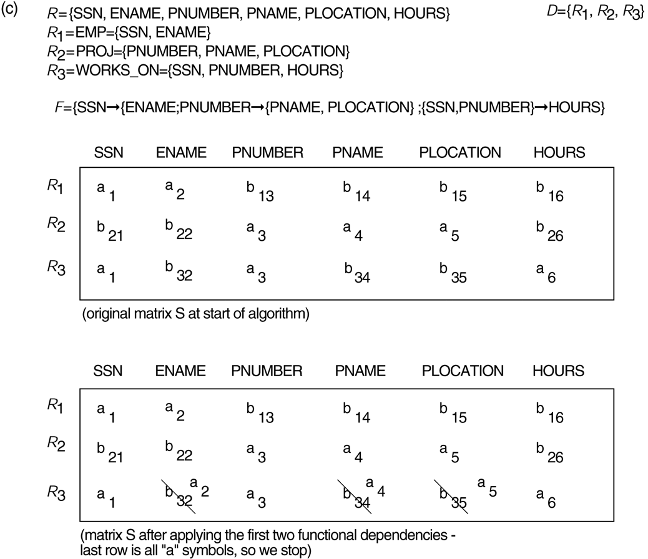
Properties of Relational Decompositions
Lossless (nonadditive) join test for n-ary decompositions. (c) Case 2: Decomposition of EMP_PROJ into EMP, PROJECT, and WORKS_ON satisfies test.

Slide 14
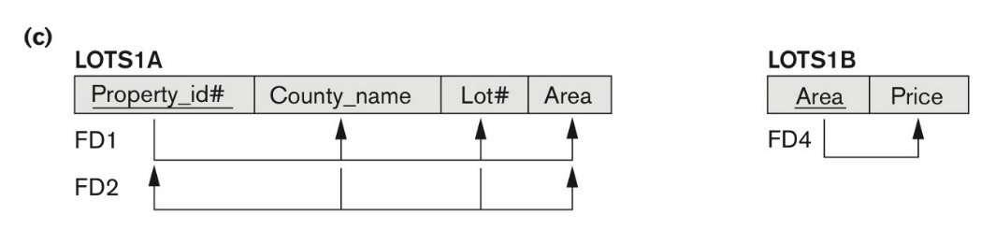
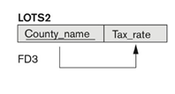
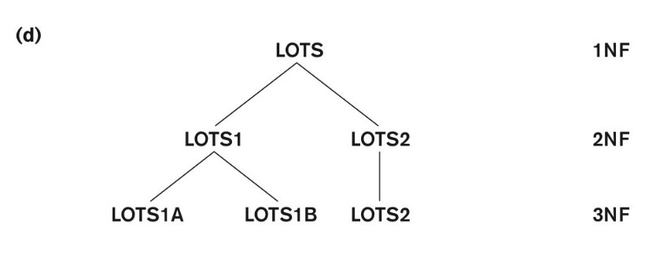
D1(P,L,C,A)
D2(A,P)
D3(C,T)
P🡪LCA
A🡪P
C🡪T
CL🡪AP

Slide 15
Properties of Relational Decompositions
Testing Binary Decompositions for Lossless Join Property
Binary Decomposition: Decomposition of a relation R into two relations.
PROPERTY LJ1 (lossless join test for binary decompositions): A decomposition D = {R1, R2} of R has the lossless join property with respect to a set of functional dependencies F on R if and only if either
The f.d. ((R1 ∩ R2) → (R1- R2)) is in F⁺, or
The f.d. ((R1 ∩ R2) → (R2 - R1)) is in F⁺.

Slide 16
Properties of Relational Decompositions
Consider a schema R (A, B, C, D) and functional dependencies A→B and C→D. Then the decomposition of R into R1(AB) and R2(CD) is ____________________
Dependency preserving and lossless join
Lossless join but not dependency preserving
Dependency preserving but not lossless join
Not dependency preserving and not lossless join
Ans: C
Decomposition of R into R1 and R2 is a dependency preserving decomposition if closure of functional dependencies after decomposition is same as closure of of FDs before decomposition.
In the above question R(A, B, C, D) is decomposed into R1 (A, B) and R2(C, D), and R1 ∩ R2 is empty. So, the decomposition is not lossless.

Slide 17
Thank you

